Slide 1
Classification of bacteria
Prepared by
DR. IHSAN EDAN ALSAIMARY
(Professor)
(Medical and molecular bacteriol & Immunol)

Slide 2
Objectives of the lecture
1-definition
2-taxonomic medels
3- grouping of bacteria
4- classification systems
5- taxonomy techniques

Slide 3
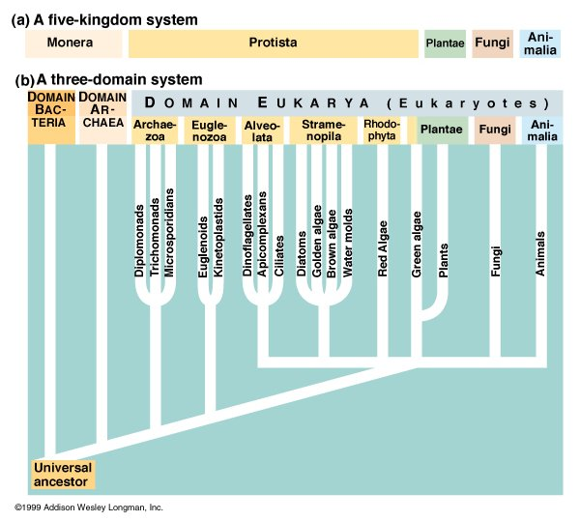

Slide 4
The Three Domains

Slide 5
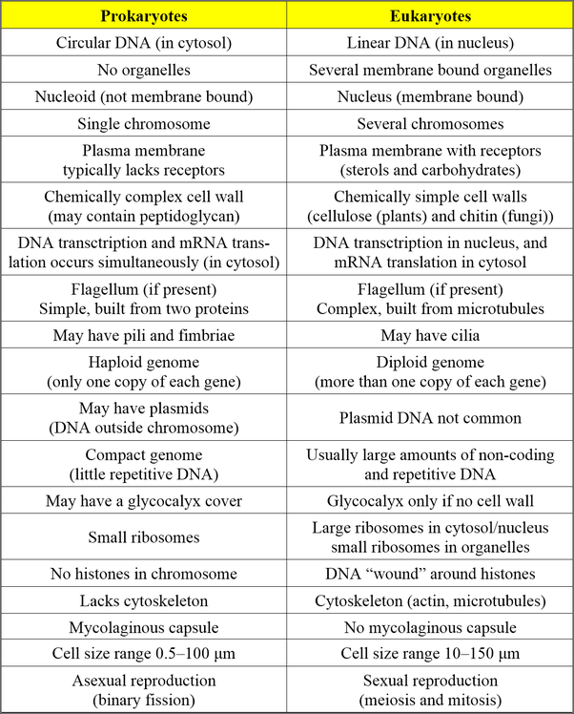

Slide 6
TAXONOMY
The study and grouping of organisms
Numerical taxonomy
Phylogenetic taxonomy
Three separte but interrelated areas
Identification
Process of characterizing organisms
Classification
Arrangement of organisms into groups
Nomenclature
Assignment of a specific name

Slide 7
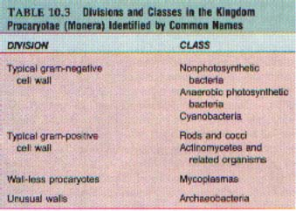
The taxonomic classification scheme for bacteria may be found in Bergey's Manual of Systematic Bacteriology. In Bergey's Manual, bacteria are divided into four divisions. Three divisions consist of eubacterial cells, and the fourth division consists of the archaeobacteria. Each division is divided into classes;

Slide 8
Archaebacteria
include three groups:
1. The methanogens, strict anaerobes that produce methane (CH₄) from carbon dioxide and hydrogen.ex: Methanococcus
Extreme halophiles, which require high concentrations of salt for survival. ex: Halococcus & Halobacterium
3. Thermoacidophiles, which normally grow in hot, acidic environments. EX : Thremus aquatiqus

Slide 9
Actinomycetes
Actinomycetes are filamentous bacteria. Their morphology resembles that of the filamentous fungi; however, the filaments of actinomycetes consist of procaryotic cells. Some actinomycetes resemble molds by forming externally carried asexual spores for reproduction.
Filamentous, High G + C content, Gram-positive
(63 – 78% GC)

Slide 10
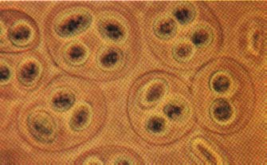
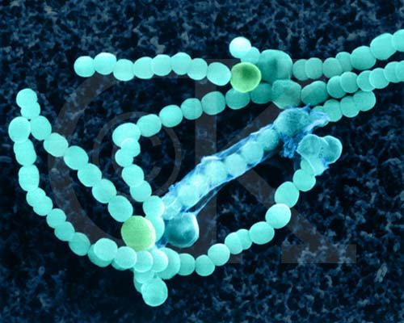
Cyanobacteria
The cyanobacteria have typical prokaryotic cell structures and a normal gram-negative cell wall.
They range in diameter from about 1 – 10 µm and may be unicellular or form filaments.
They have chlorophyll and carry out oxygen-producing photosynthesis, much as plants and the eukaryotic algae do.

Slide 11
Classification Methods:
Dichotomous keys
Widely used, based upon questions each of which has two possible answers, eventually get to identification
Cladograms are used to show degrees of evolutionary relationship

Slide 13
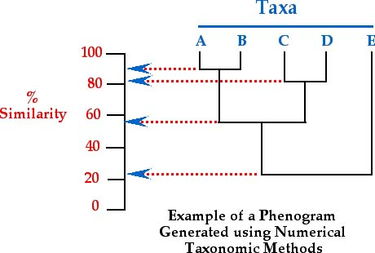
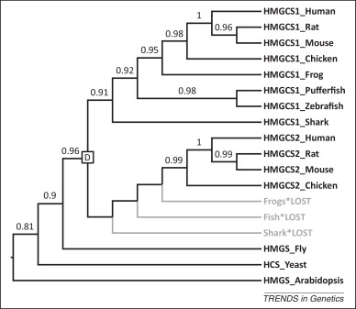
Cladogram: numerical taxonomr

Slide 14
TAXONOMY
Initial identification of microorganisms results in their classification
Based on evolutionary relationships
Identification of microorganisms in particular environments remains important
e.g., Microbial contaminants can spoil food
e.g., Identification of microbes present in a clinical patient is important in determining treatment

Slide 15
PROKARYOTE IDENTIFICATION
Various techniques are employed to characterize and identify microorganisms
Phenotypic characteristics
Microscopic morphology
Metabolic differences
Serology
Fatty acid analysis
Genotypic characteristics
Nucleic acid probes
DNA amplification
rRNA sequencing

